Slide 1
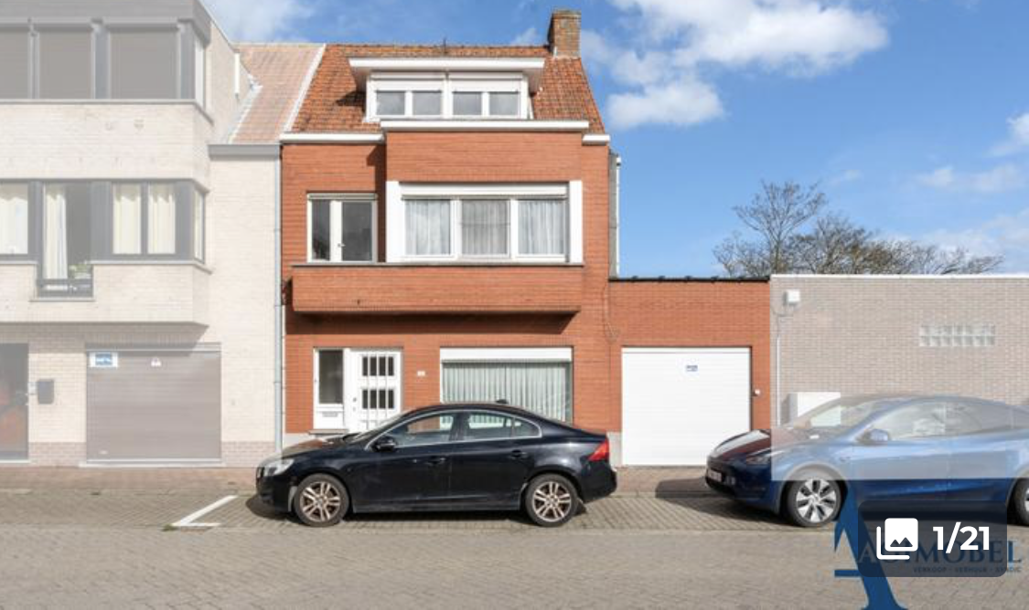
ORIGINAL

Slide 2


